Slide 1
Web Traffic Time Series Forecasting
MScA Time Series Project
Presented by
Crystal Xu, Ruoxin Shi, Xueting Wang, Yifan Guo

Slide 2
Table of contents
01
Introduction
03
Models
02
Exploratory Data Analysis
04
Results & Future Work

Slide 3
Introduction Problem Statement Assumptions

Slide 4


Problem Statement
Wikipedia is a popular search tool for the public to learn basic information. The daily web traffic of topics on Wikipedia is typical time-series data. For the benefit of Wikipedia, it is useful to forecast the daily views of different topics and trending words. For public opinion monitoring, it is important to track and forecast the future views of certain topics. Hence, this project will focus on the prediction of the daily views of topics on Wikipedia. To make our project more concentrated, only one topic is focused as the predicted target, and other domains of the same topic as related time series data. Both univariate and multivariant models are applied.
Assumptions – Assume data has trend and seasonality

Slide 5
Exploratory Data Analysis Data Description Data Preprocessing EDA

Slide 6
Dataset Description
Time Span : 2015.07.01 – 2017.9.10 Number of website pages: 145,063
Page | 2015.07.01 | 2015.07.02 | … | 2017.09.08 | 2017.9.09 | 2017.09.10
2NE1_zh.wikipedia.org_all-access_spider | 22 | 11 | … | 23 | 24 | 19
Beautiful_Mind_zh.wikipedia.org_all-access_spider | 25 | 3 | … | 17 | 16 | 9
BLACK_PINK_zh.wikipedia.org_all-access_spider | 19 | 16 | … | NA | 13 | NA
Angelababy_zh.wikipedia.org_all-access_spider | 20 | 14 | … | 18 | NA | 14
BIGBANG_zh.wikipedia.org_all-access_spider | 12 | 10 | … | 15 | 23 | 15
Facebook_zh.wikipedia.org_all-access_spider | 65 | 42 | … | 50 | 78 | 69

Slide 7
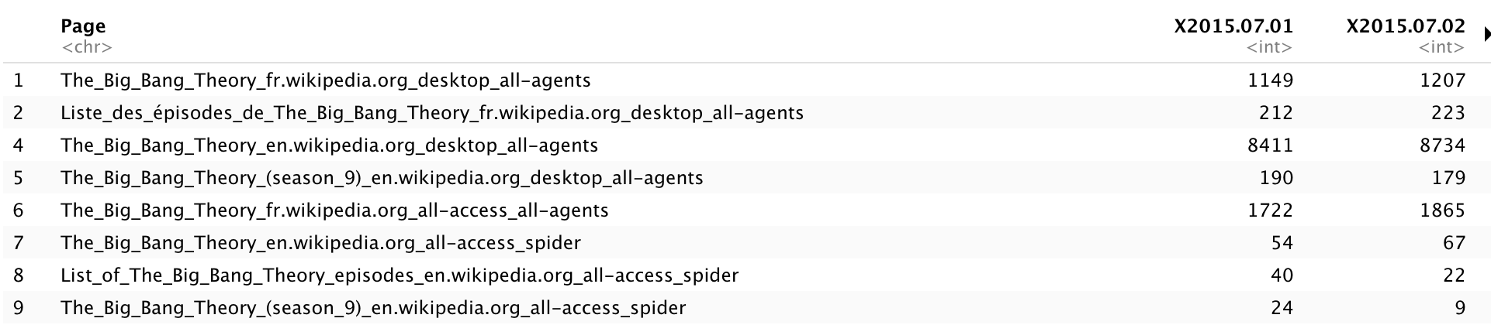
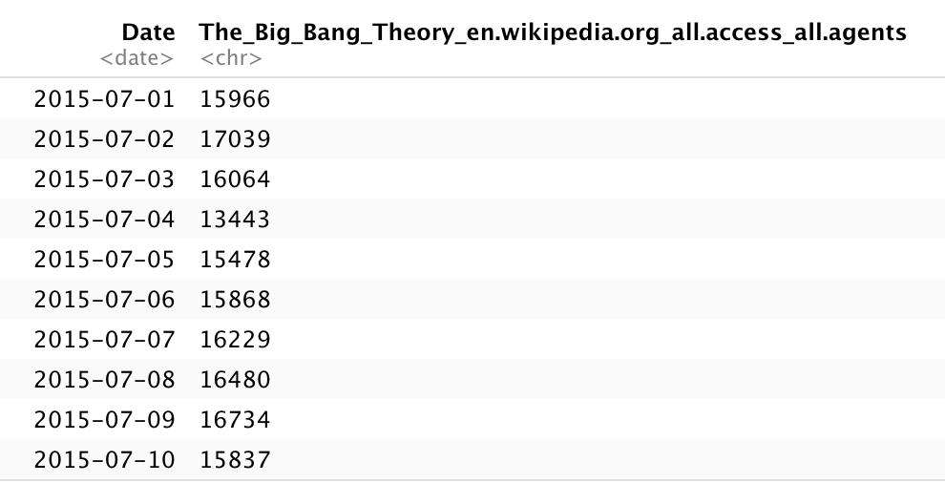

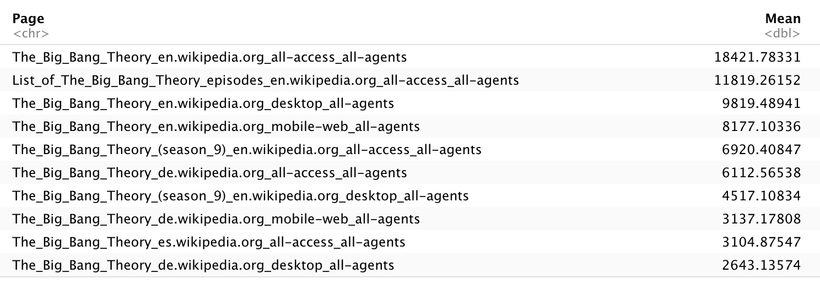
Data Cleaning
Keep only websites end with Wikipedia.org
Extract all The Big Bang Theory’s websites
Drop null values
Drop # of records from 145,063 to 117,277
Sort the mean values of web traffic for The Big Bang Theory
Select the highest domain website as our predicted Y and others as related time series

Slide 8
Data Ready for Analysis
Number of domain pages: 28
Date | The Big Bang Theory _en.wikipedia.org_all.access_all.agents | The Big Bang Theory fr.wikipedia.org_desktop_all.agents | The Big Bang Theory .season_9._en.wikipedia.org_desktop_all.agents | The Big Bang Theory de.wikipedia.org_all.access_spider | …
2015-07-01 | 15966 | 1149 | 212 | 3 | …
2015-07-02 | 17039 | 1207 | 213 | 12 | …
2015-07-03 | 16064 | 1140 | 193 | 5 | …
2015-07-04 | 13443 | 1459 | 179 | 9 | …
… | … | … | … | … | …
2017-09-10 | 16021 | 1193 | 183 | 7 | …

Slide 9
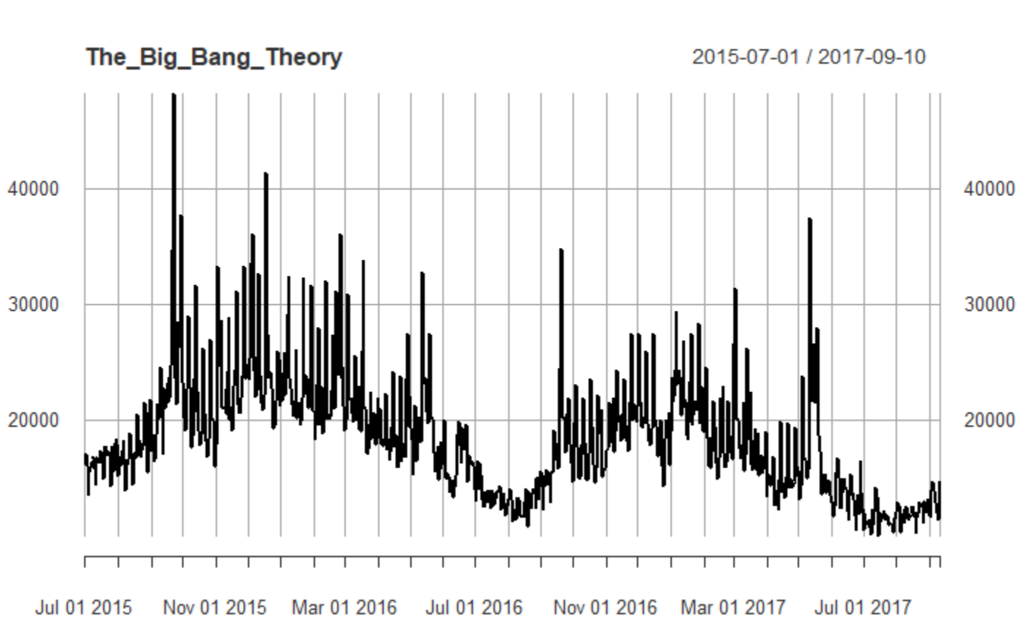
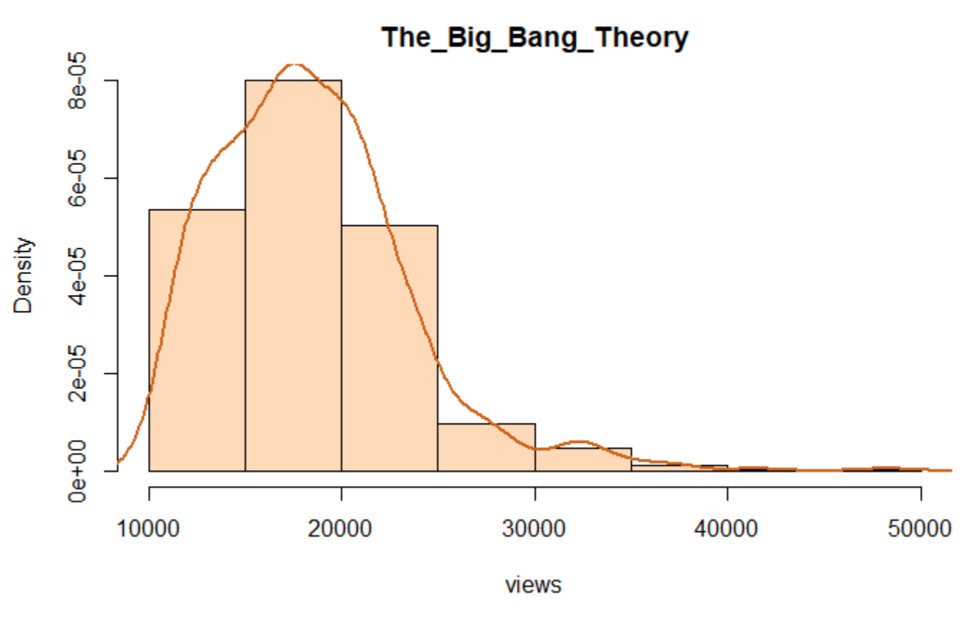
EDA
Plot the main Time Series Data
Observed seasonality and outliers from the graph
The distribution closed to a Poisson distribution

Slide 10
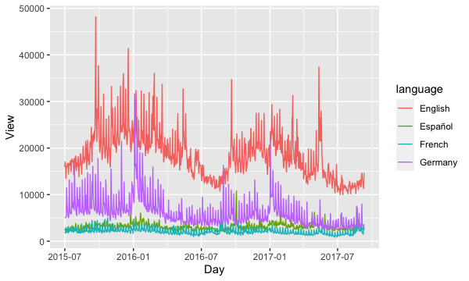
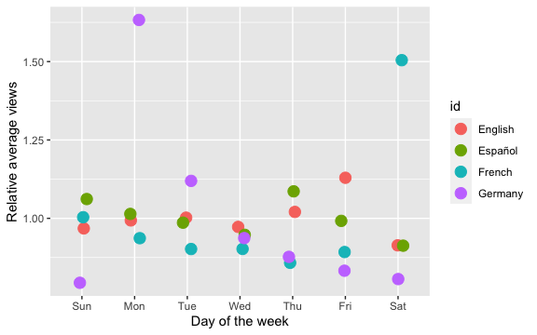
EDA
Comparison
Weekday Variation
English website domain has the highest number of clicks overall; The curves are similar for different languages.
Different language websites do not have the same pattern across a week
Generally, the views go down from Sunday to Wednesday and then have an upward trend during the second half of the week

Slide 11
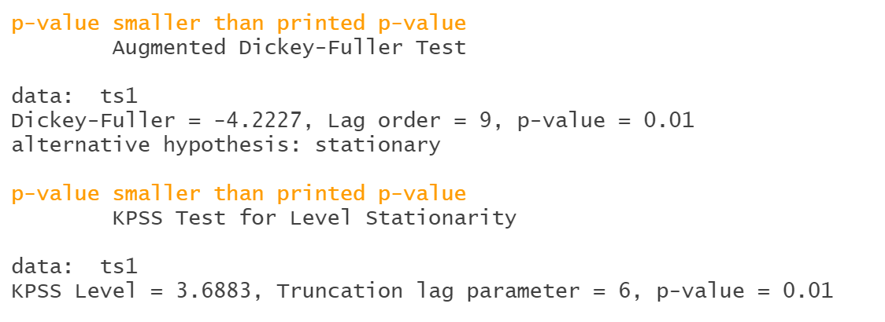
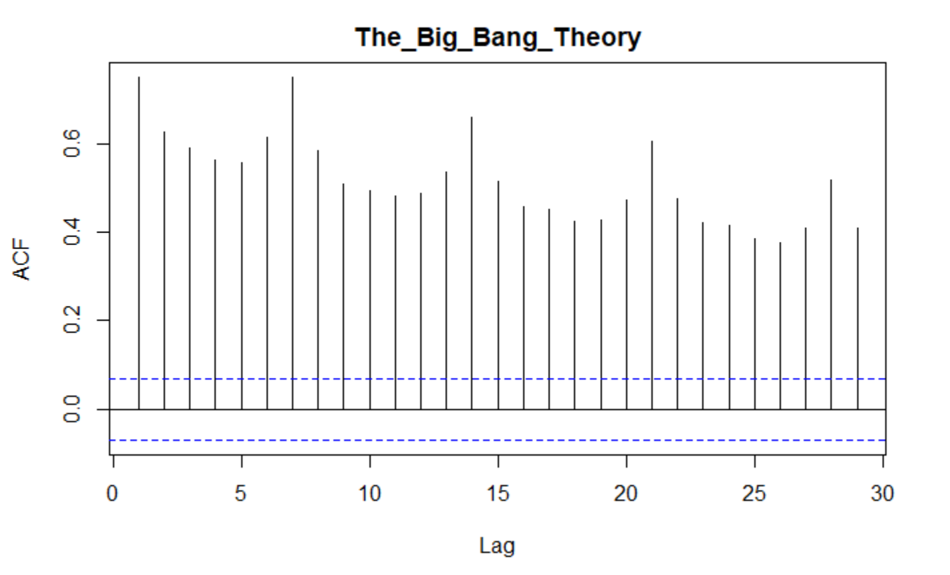
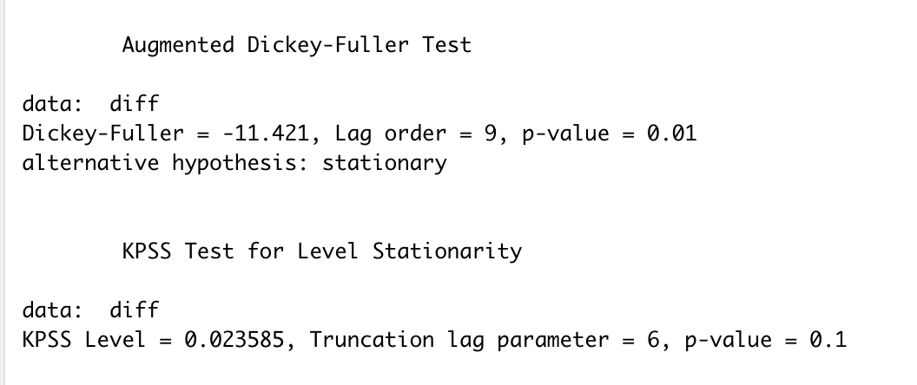
KPSS indicates non-stationarity and ADF indicates stationarity - Difference Stationary
EDA
Stationarity
Take first difference
KPSS indicates stationarity and ADF indicates stationarity

Slide 12
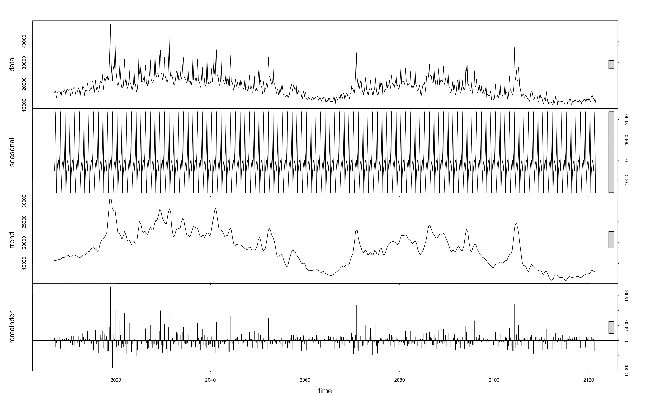
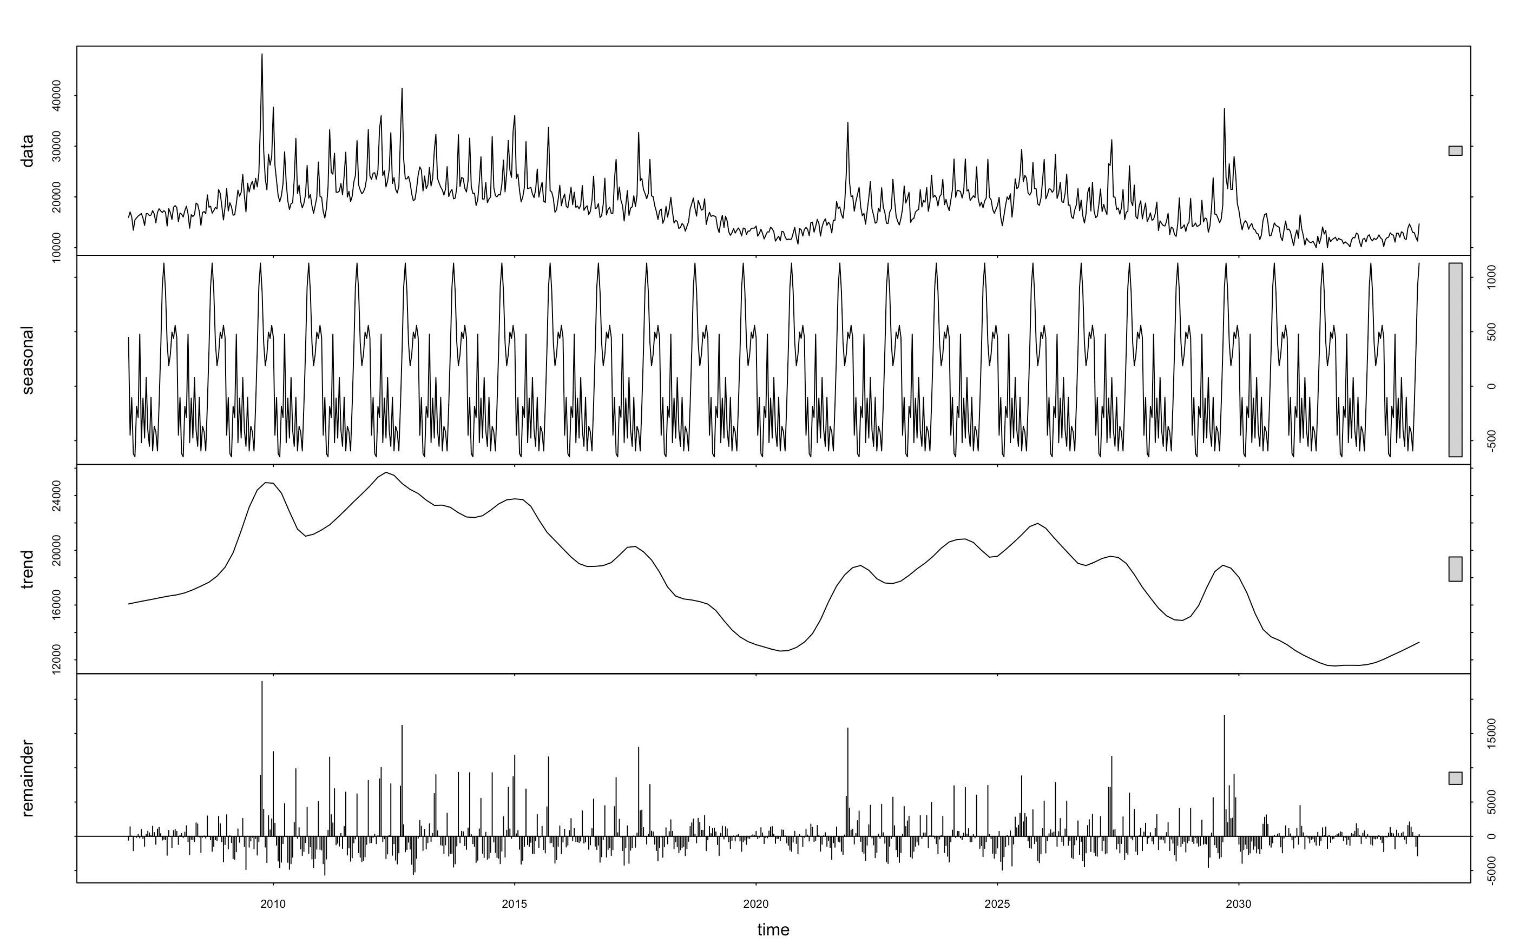
EDA
Seasonality
Weekly
Monthly
Weekly seasonality has effect [-1500,2200]. Monthly seasonality has effect [-600, 1100]

Slide 13
Models Feature Engineering Models : ARIMA, PROPHET, STL, LSTM, GRU, CNN Model Evaluation

Slide 14
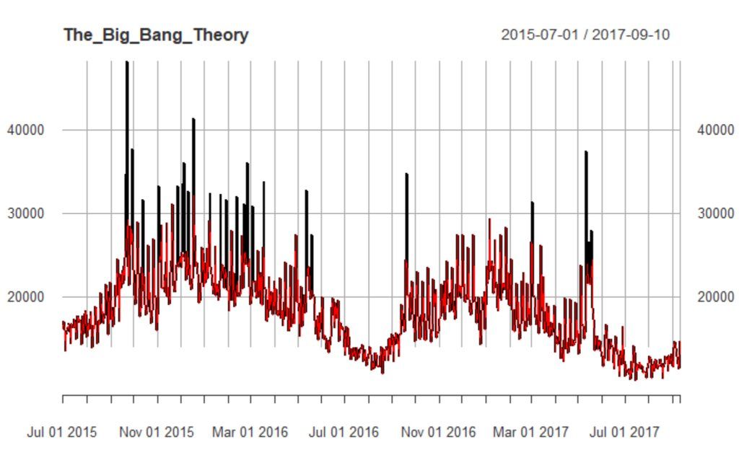
Feature Engineering
SARIMA
Convert to TS object
STL + ARIMA
Remove Outliers
Prophet
Box-Cox Transformation
LSTM
Min-Max Scaler
GRU
Lag data by 1, 2, 3, and 7 days
CNN
Prediction on two months period
Train & Test Split
2015.07.01 – 2017.07.10
2017.07.11 – 2017.09.10

Slide 15
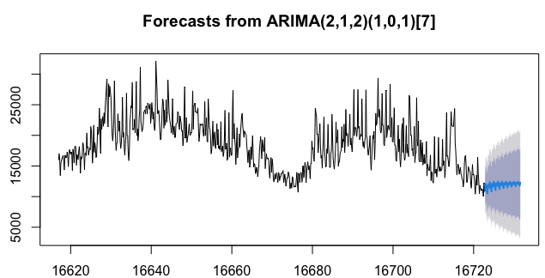
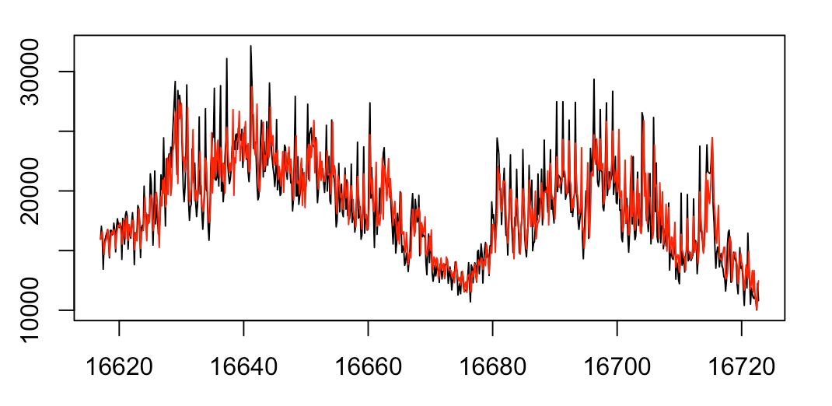
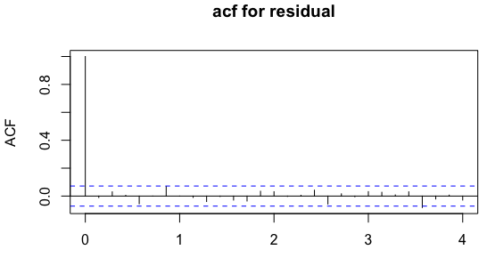
Models
SARIMA
Predicted vs. Actual
 | ME | RMSE | MAE | MPE | MAPE | MASE | ACF1
Training Set | 23.627 | 1940.2856 | 1405.375 | -1.023 | 7.305 | 0.733 | -0.00098
Test set | 85.995 | 864.724 | 634.8691 | 0.202 | 5.182 | 0.331 | NA

Slide 16
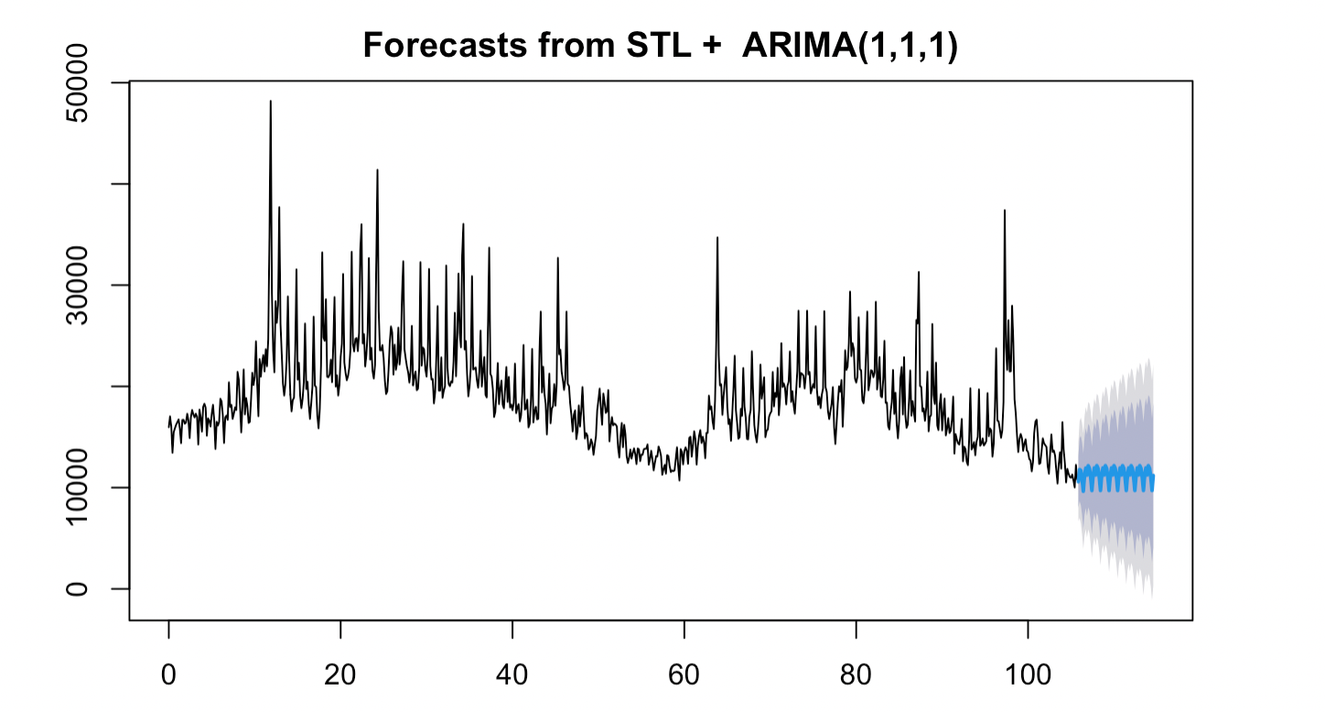
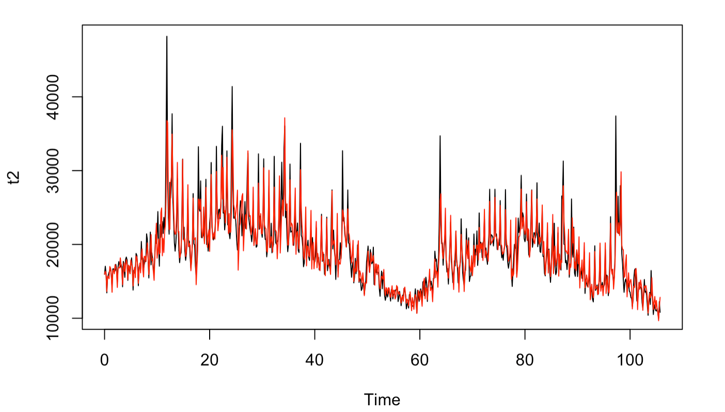
Models
STL + ARIMA
Predicted vs. Actual
 | ME | RMSE | MAE | MPE | MAPE | MASE | ACF1
Training Set | -17.618 | 1983.210 | 1304.862 | -0.798 | 6.478 | 0.530 | 0.00126
Test set | 735.615 | 1176.074 | 899.1512 | 5.763 | 7.231 | 0.365 | NA

Slide 17
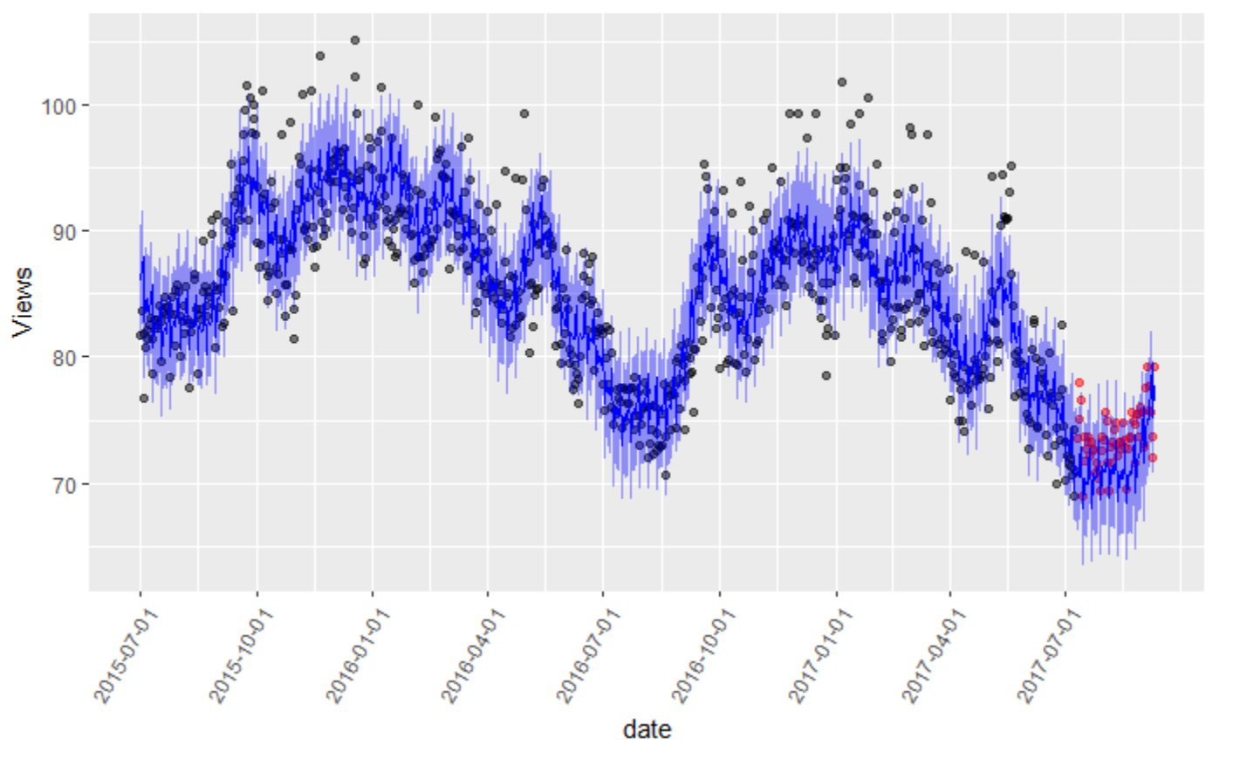
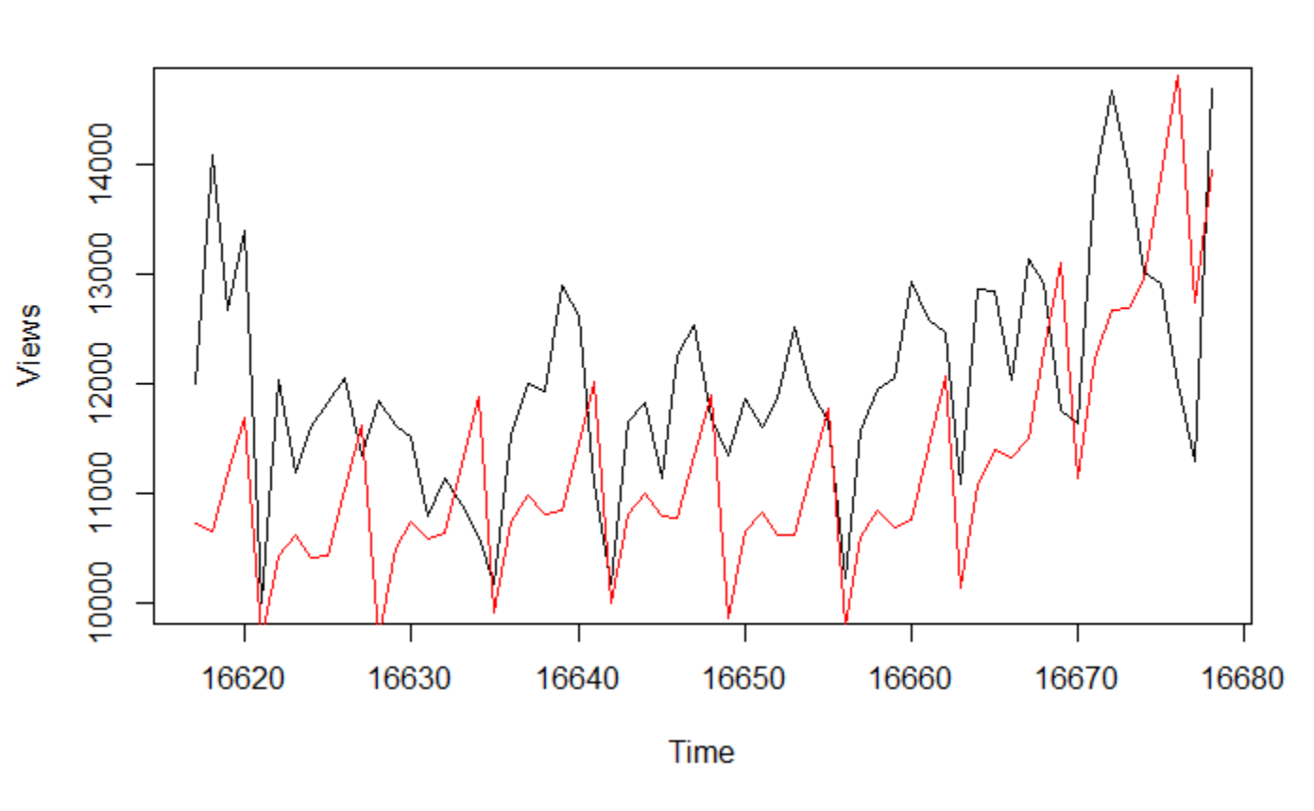
Models
PROPHET
MAPE for original y : 8.908133
MAPE for transformed y : 3.338573
Predicted vs. Actual

Slide 18
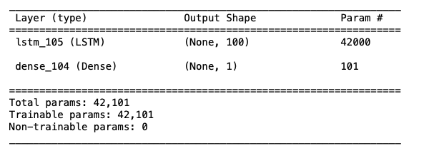
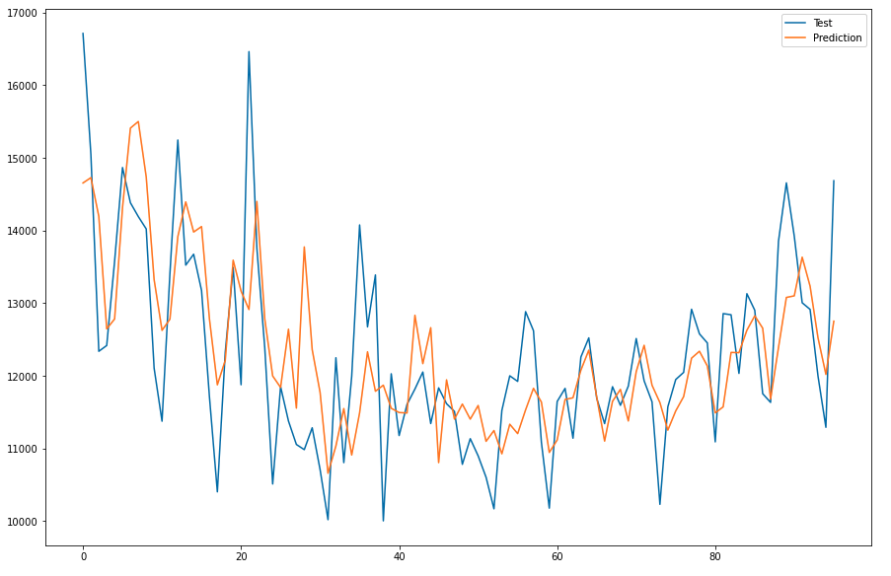
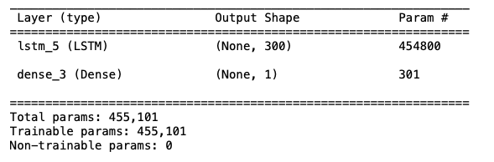
Models
LSTM
Univariate vs. Multivariate Model (T-1,T-2,T-3,Seasonality(T-7))
Univariate Model
Predicted vs. Actual
Univariate Model
Summary
Multivariate Model
Summary
Model | MAPE | RMSE | MAE
Univariate | 6.37 | 1006.93 | 786.57
Multivariate | 8.24 | 2521.76 | 1040.48

Slide 19
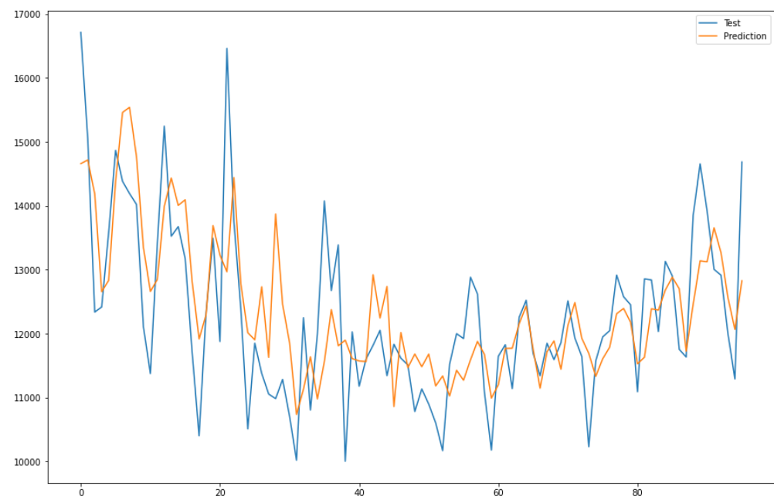
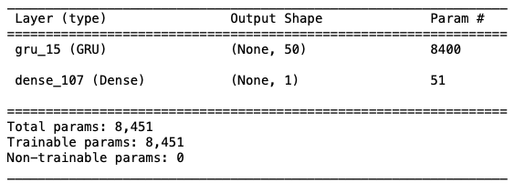
Models
GRU
Univariate Model (T-1,T-2,T-3,Seasonality(T-7))
MAPE | RMSE | MAE
6.4 | 1010.98 | 787.15

Slide 20
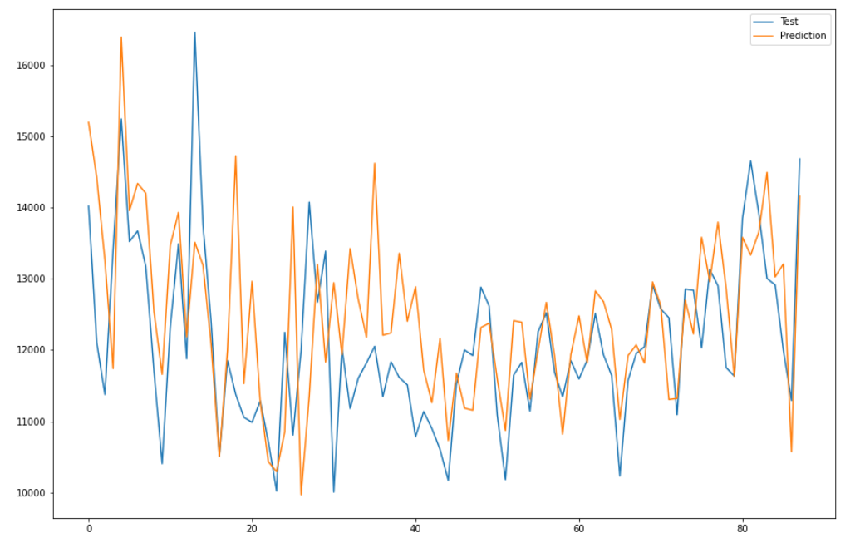
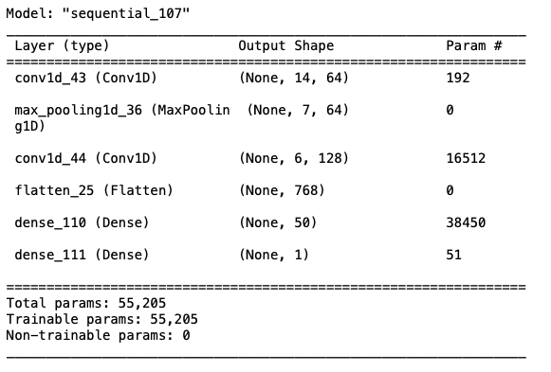
Models
CNN
Univariate Model, 1-dimension
MAPE | RMSE | MAE
11.39 | 1187.77 | 874.87

Slide 21
Results Model Comparison Future Works

Slide 22

Results
Model Comparisons
Model | MAPE | RMSE | MAE
SARIMA | 5.182 | 864.76 | 634.87
STL + ARIMA | 7.231 | 1176.074 | 899.151
PROPHET | 8.91 | 1248.14 | 1062.43
LSTM (Uni) | 6.37 | 1006.93 | 786.57
LSTM (Multi) | 8.24 | 2521.76 | 1040.48
GRU | 6.4 | 1010.98 | 787.15
CNN | 11.39 | 1187.77 | 874.87
Comparing across all the models using the metrics MAPE, RMSE, and MAE, we found that SARIMA model has the best performance overall.

Slide 23
Future Works
Further explore correlations among different domains
Explore whether different branches from the same topic has effect on the main page
Preform forecast on other topics and their domains
Tune the deep learning models' parameters to find the better result, such as using batch normalization, learning rate schedule, K-fold cross validation
Using GluonTS as pretrained model

Slide 24
Thanks!
GitHub link https://github.com/crystal997/Projects/tree/master/TS%20Final%20Project

